Slide 1
Home Health Care Providers of America
By: Seth Remo

Slide 2
Goals
Determine the top 5 and bottom 5 states when it comes to patient reviews and surveys.
Display how every state compares to the rest.
Show the locations of every provider to determine if there are any correlations.
Extract the top 25 Providers in the country and the bottom 25 Providers in the country.
Try and find a correlation between total score and median household income data.

Slide 3
Total Score
I have given each provider and state a total score and what this score does is it takes each category in the dataset and determines if it is a positive or negative and then it totals up the numbers to give a final score ranging from about 650 to 1300 (1300 being the best).
ie Percent of patients who reported that their home health team discussed medicines, pain, and home safety with them = Positive
ie How often patients developed new or worsened pressure ulcers = Negative

Slide 4




Slide 5
Best and Worst 5 States based on Score

Slide 6
Income Rankings vs Score Rankings
Income Rank is a ranking based on the median household income data from 2017, where #1 is the state with the highest median income and #50 is the lowest median income.
Score Rank is a ranking based on the total score column where #1 has the highest score and #50 has the lowest score.

Slide 7
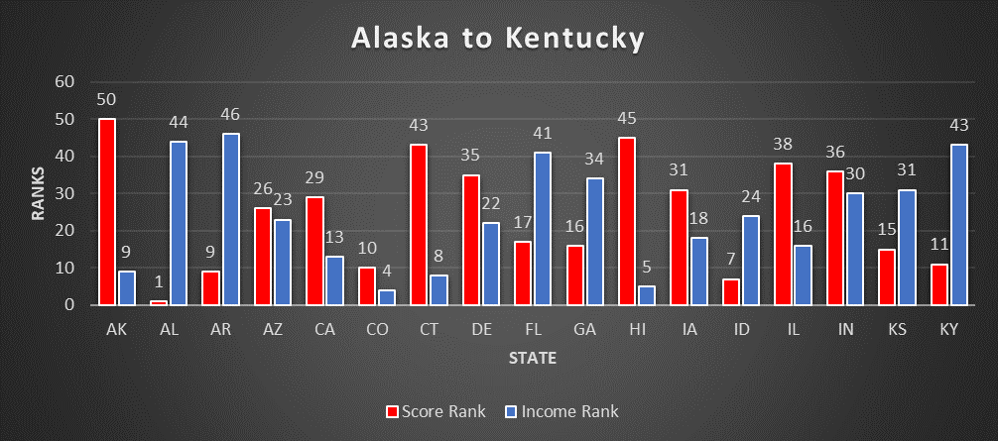

Slide 8
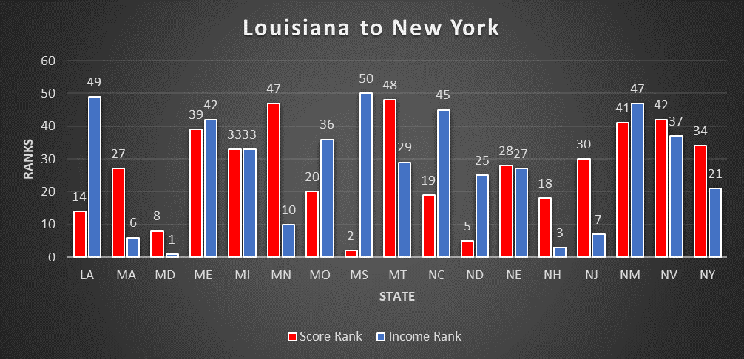

Slide 9
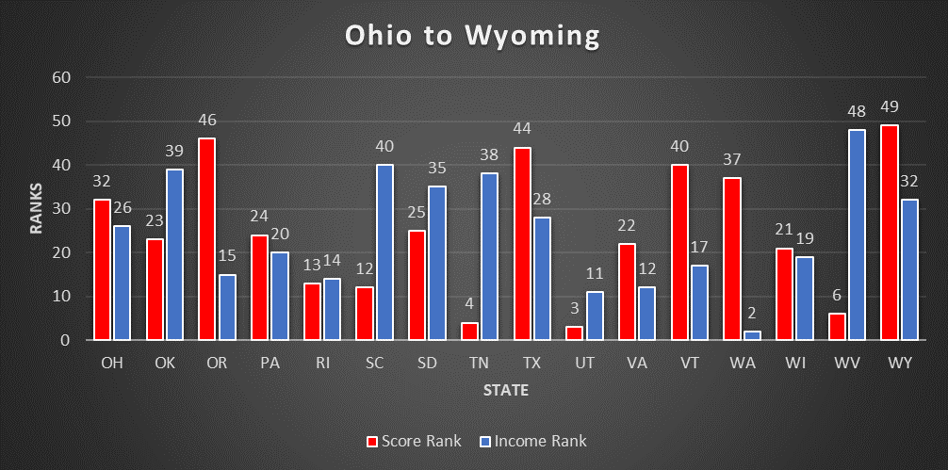

Slide 10
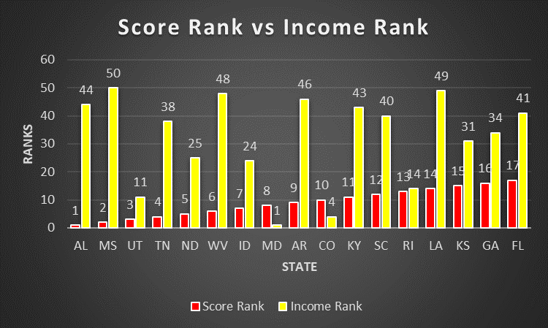

Slide 11
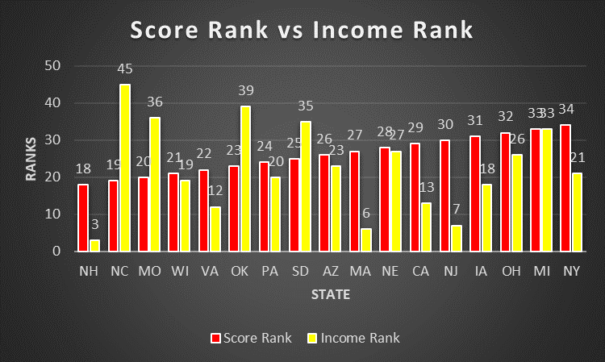

Slide 12
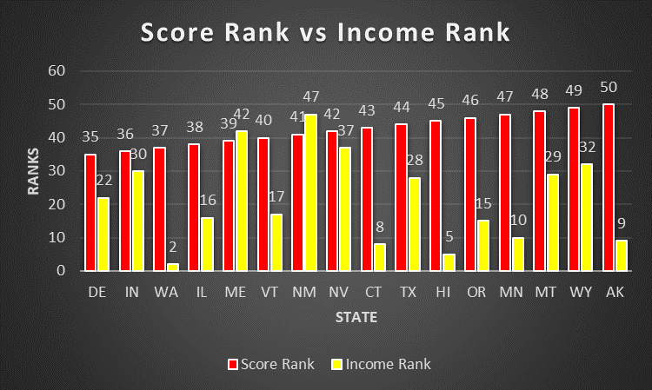

Slide 13
What These Charts Tell Us
Alabama, Mississippi, and Louisiana have a very low median household income, but still show up with very high scores.
It almost seems as if the lower the median household income rank the higher the score rank
Our very own state of Tennessee has a low Income Rank(#38), but still manages a high Score Rank(#4)

Slide 14
Top Providers
I took the total score from each provider and found the top 100 and bottom 100 providers.

